Slide 1
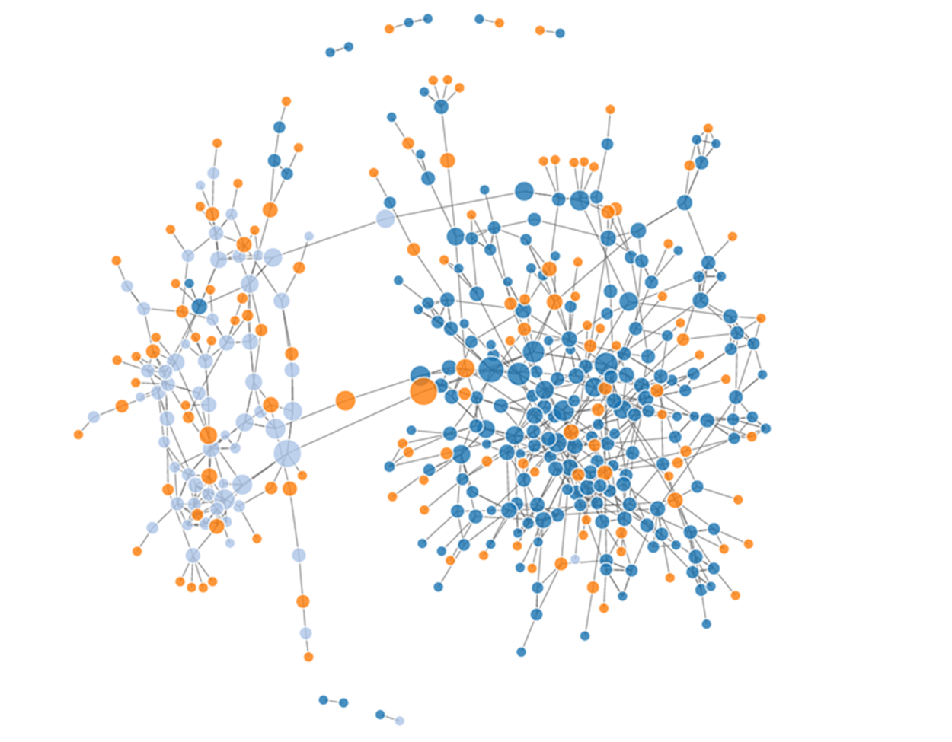
Social Network Analysis Workshop Glasgow, Scotland - July 2018
Prof James P Curley
@jalapic
Associate Professor
Psychology Department
University of Texas at Austin

Slide 2
The Study of Social Dynamics

Slide 3
Data from 1880–1881
German teacher Johannes Delitsch published in 1900 in ‘Zeitschrift für Kinderforschung’ (‘Journal of Child Study’).
| = Ingoing friendship relations (“angebotene Freunschaften”) - Child in column befriends child in row.
+ = Reciprocated friendships (“geschlossene Freundschaften”)

Slide 4
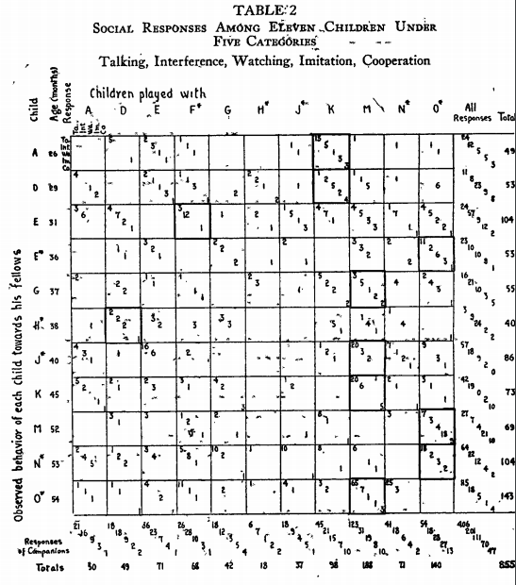
Helen Bott 1928
Observation of play activities in a nursery school.
talked to another
interfered with another
watched another
imitated another
cooperated with another

Slide 5

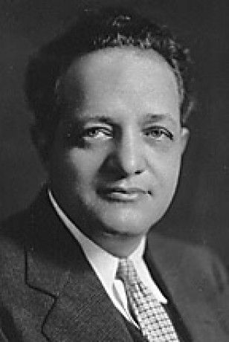
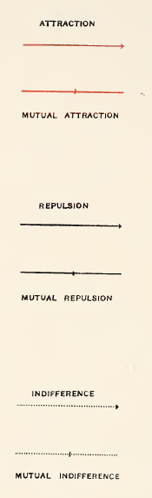
Jacob Levy Moreno
1934

Slide 6
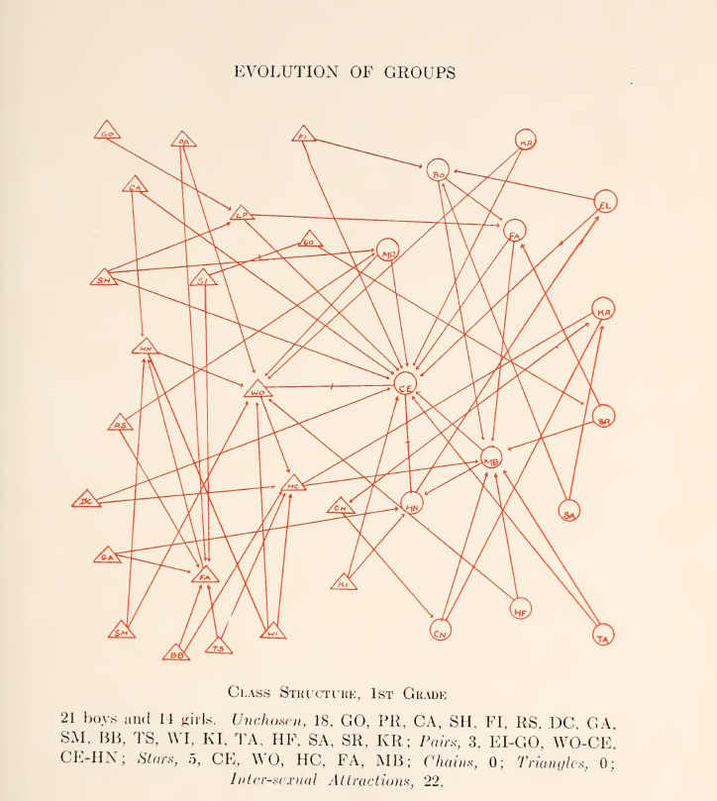
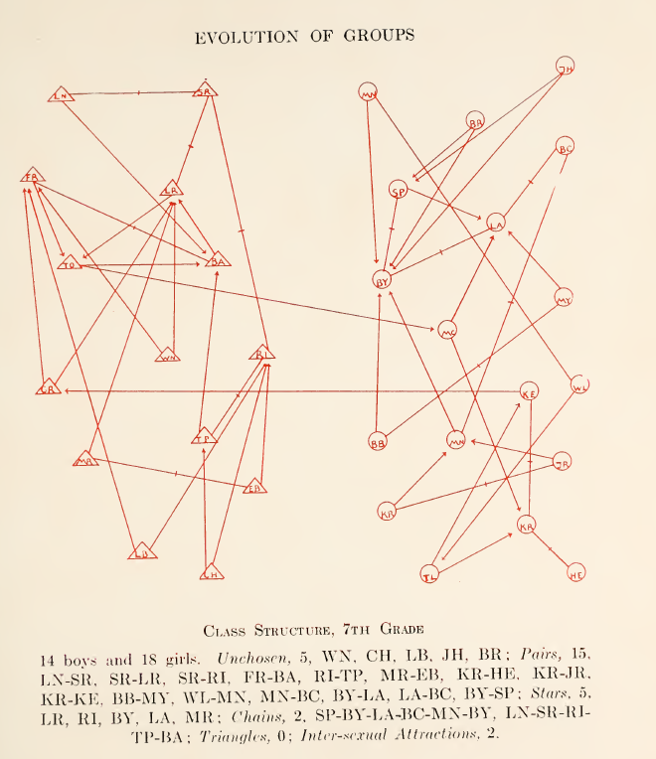
Notes:
It was required to choose among their classmates those whom each wants to have stay in the same classroom and to sit near him. At P.S. 181 in Brooklyn.

Slide 7
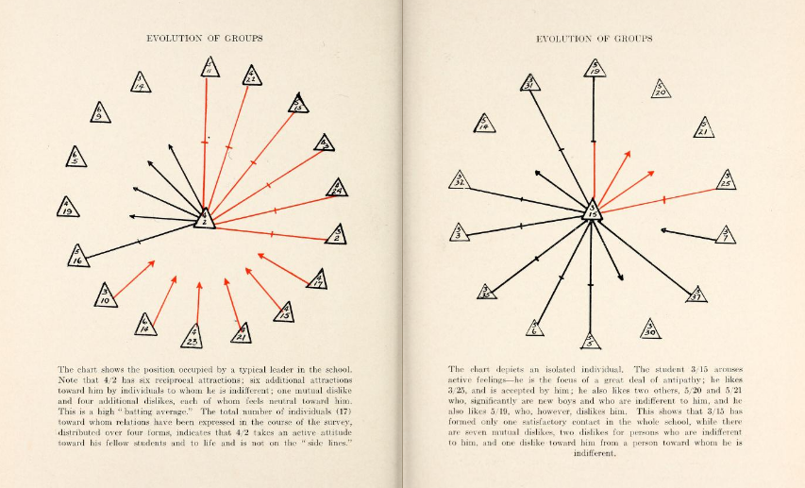
Social atom

Slide 8
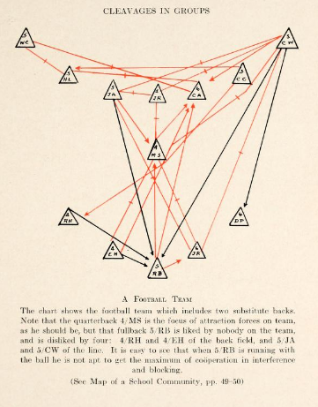

Slide 9
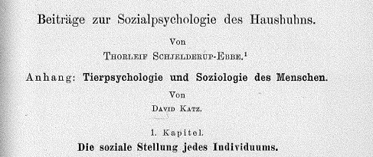
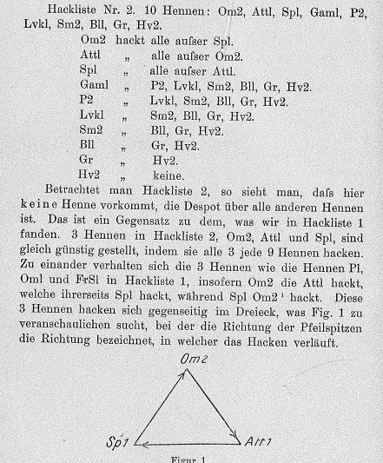
Thorleif Schjeldrup-Ebbe 1922
First demonstration of a social hierarchy in animals (chickens)
Demonstrated transitivity as feature of linear social hierarchies
Illustration of Network Intransitivity

Slide 10
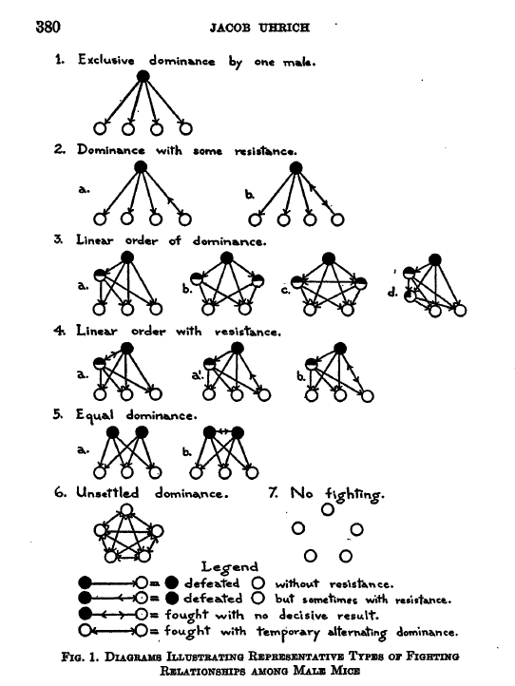
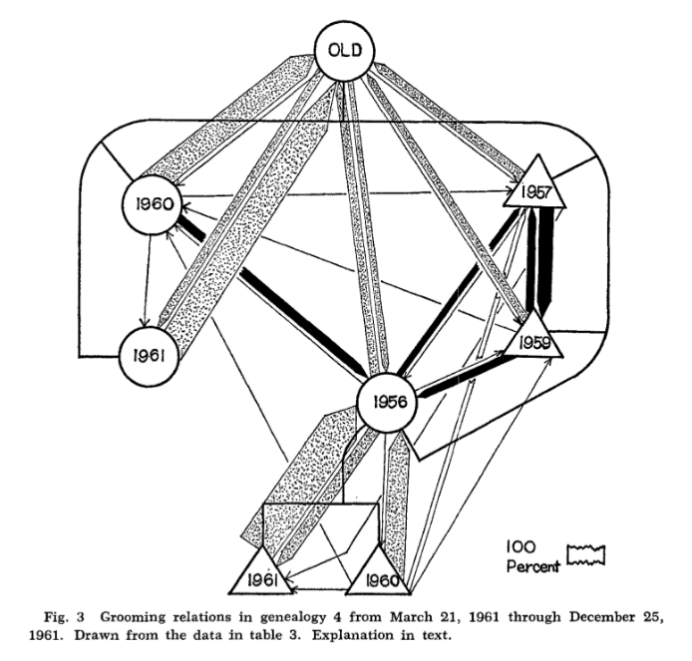
Jacob Uhrich 1937
Donald Sade 1965

Slide 11
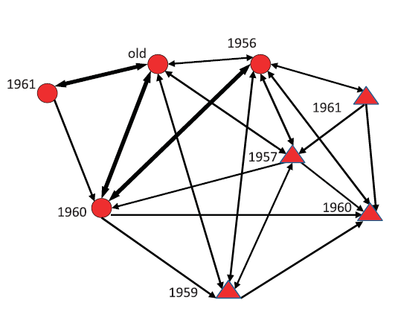
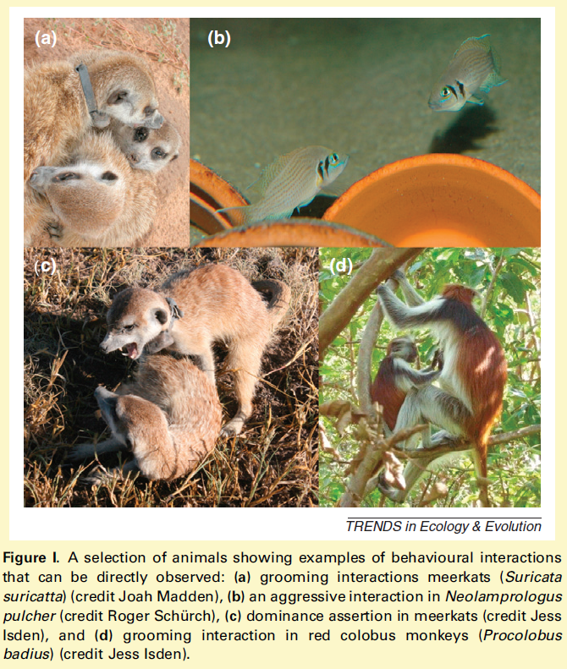
Explosion of Animal Social/Interaction Network Analyses
SNA makes it possible to build up larger social units and structures from observations of pair-wise interactions
In social groups, an individual’s interaction with another individual is unlikely to be independent of its interactions with others
Croft et al 2011 TREE
Brent et al 2010 Am J Primatol

Slide 12
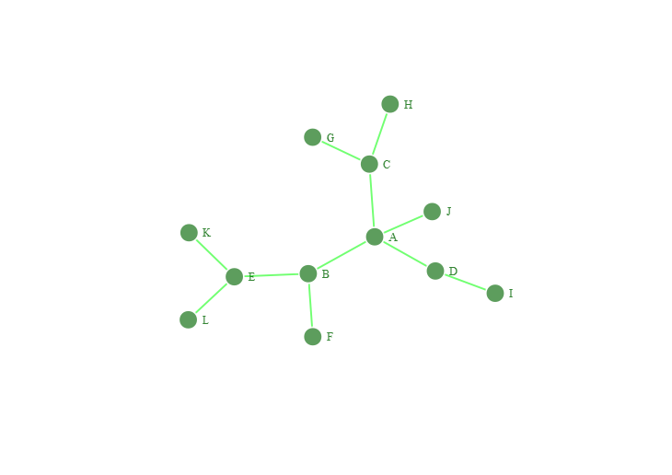
What is a Social Network ?

Slide 13
Data Structures
Edgelist
Sociomatrix / Adjacency Matrix
Network / Sociogram
A
A
A
A
B
B
C
C
D
E
E
B
C
D
J
E
F
G
H
I
K
L
 | A | B | C | D | E | F | G | H | I | J | K | L
A | . | 1 | 1 | 1 | 0 | 0 | 0 | 0 | 0 | 1 | 0 | 0
B | 1 | . | 0 | 0 | 1 | 1 | 0 | 0 | 0 | 0 | 0 | 0
C | 1 | 0 | . | 0 | 0 | 0 | 1 | 1 | 0 | 0 | 0 | 0
D | 1 | 0 | 0 | . | 0 | 0 | 0 | 0 | 1 | 0 | 0 | 0
E | 0 | 1 | 0 | 0 | . | 0 | 0 | 0 | 0 | 0 | 1 | 1
F | 0 | 1 | 0 | 0 | 0 | . | 0 | 0 | 0 | 0 | 0 | 0
G | 0 | 0 | 1 | 0 | 0 | 0 | . | 0 | 0 | 0 | 0 | 0
H | 0 | 0 | 1 | 0 | 0 | 0 | 0 | . | 0 | 0 | 0 | 0
I | 0 | 0 | 0 | 1 | 0 | 0 | 0 | 0 | . | 0 | 0 | 0
J | 1 | 0 | 0 | 0 | 0 | 0 | 0 | 0 | 0 | . | 0 | 0
K | 0 | 0 | 0 | 0 | 1 | 0 | 0 | 0 | 0 | 0 | . | 0
L | 0 | 0 | 0 | 0 | 1 | 0 | 0 | 0 | 0 | 0 | 0 | .

Slide 14
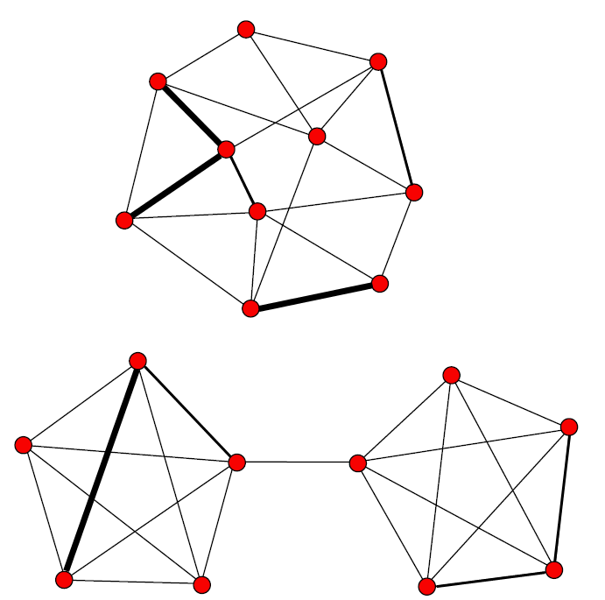
Advantages of SNA
Can measure traditional individual indices of social interaction (e.g. degree = number of social partners, strength = frequency of interaction)
Can ascertain additional measures of an individuals sociality via indirect connections e.g. eigenvector centrality = number of social partners that one’s own social partners additionally possess)
Can also detail social structure of entire network - e.g. assortativity = tendency of nodes of one class to connect to nodes of the same class which leads to sub-clusters & presence of brokers (individuals who bridge relationships between clusters)
Across taxa, SNA metrics at the individual, relationship and social structure levels are related to various measures of fitness e.g. social learning, stress, dominance, cooperation

Slide 15
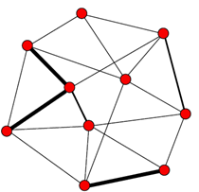
SNA measures
Degree centrality - how many direct ties an individual has with others.
Eigenvector centrality = number of social partners that one’s own social partners additionally possess
Outdegree - the number of ties that originate from the focal animal (e.g., the number of grooming events initiated by the focal animal)
Indegree - the number of ties that are directed at the focal animal (e.g., the number of grooming events that the focal animal receives).
Strength - the number or rate of interactions (e.g., grooming events) between a pair of animals
Average path length (L) - the average distance between pairs of individuals within a
network . High L scores indicate that some individuals only interact with others very indirectly.
Compactness - how directly connected individuals in the network are (controlling for the size of the network)
Density (D) - how many potential ties between individuals are actually present. Expressed as a percentage, with high scores indicating ‘saturated’ networks (all possible ties are present) and low scores indicating ‘sparse’ networks
Clustering coefficient (C) – how ‘cliquish’ the network is. High C scores indicate that on average, focal individuals are surrounded by other individuals that are well connected to each other
Betweenness - the extent to which an individual is between all other individuals within the network.

Slide 16
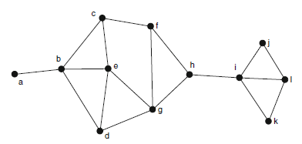
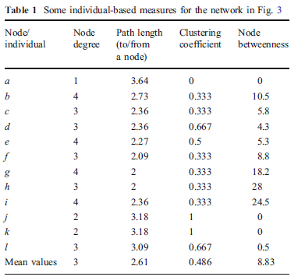
Number of immediate neighbors
Degree to which an individual’s immediate neighbors are connected
Average number of connections between individual & any other individual
The number of shortest paths between pairs of individuals that pass through an individual
Krause et al 2009 Behav Ecol Sociobiol

Slide 17
What sort of questions can be asked & answered using SNA?
Individual Level
What individual characteristics (personality/sex/age/etc.) predict an individuals position within a SN?
How does the introduction/removal of specific individuals alter the SN?
How do animals of similar/dissimilar strains/genetics assort in a SN?
How does an individual’s position in the network affect their future reproductive success, well-being, health, etc. ?
Does an individual’s position in the network correlate with brain specific phenotypes?
Network Level
How does the number & characteristics of individuals alter the composition of the SN?
How does the external environment (e.g. physical space) alter the composition of the SN?
How do different network types facilitate the spread of information, disease, cooperation, etc.?
Do young animals establish different social networks to old animals?

Slide 18
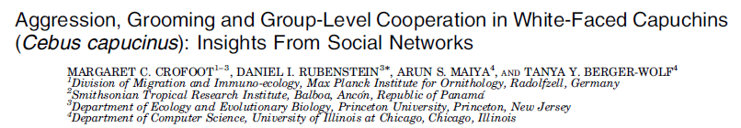
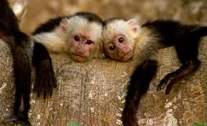
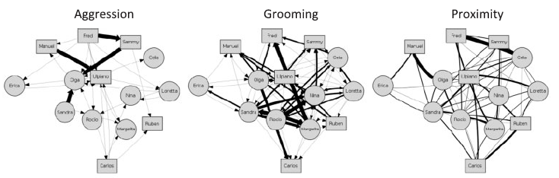

Slide 19
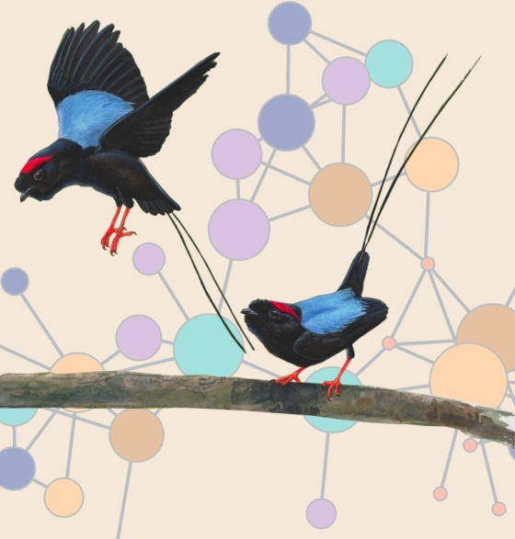
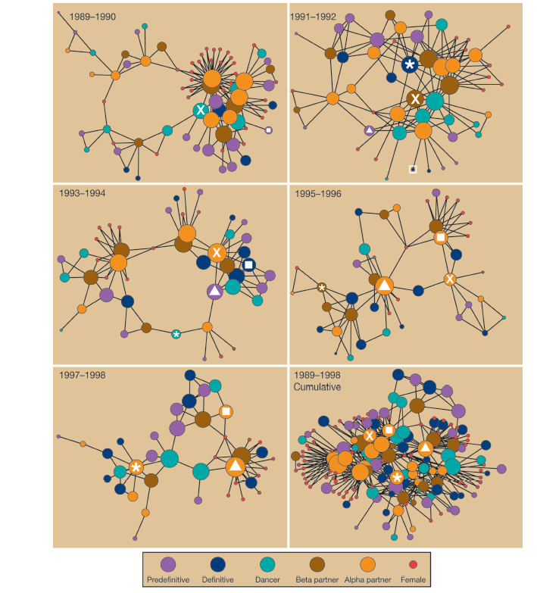
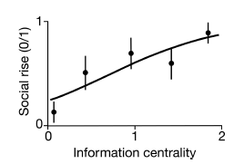
The centrality of young male long-tailed Mannakins predicts their social rise 4.8 years later – Centrality of adult males did not predict social status
McDonald 2007 PNAS

Slide 20
Using R packages to analyze social networks
igraph
statnet
sna
network
intergraph
keyplayer
Rsiena
ergm
tsna
timeordered
asnipe
assortnet
anidom
compete
….
many others
Packages for global manipulation of network data
Packages modeling specific features of social networks
Packages that are more specific for animal behavior
(there are many ! – these are just some examples)

Slide 21
Visualizing Networks

Slide 22
Social associations that are observed between individuals over time …
… how to best visualize these sociotemporal patterns ?

Slide 23
What to visualize ?
What questions are you interested in?
What do we want to communicate ?
Who is the audience ?
How do you want it to be viewed ?
What works best for your particular workflow?

Slide 24
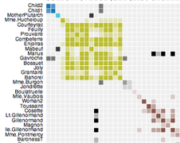
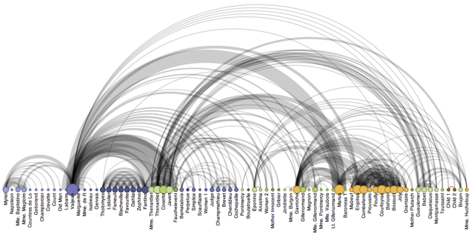
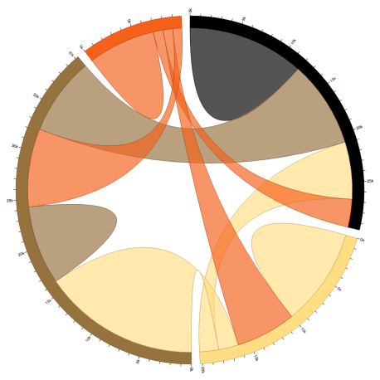
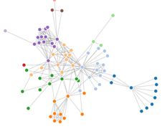
What to visualize ?
- Sociomatrices
Social Networks
Social Atom
Chord diagrams
Arc diagrams
Hierarchical trees
Timeline/Time-ordered networks
etc.

Slide 25










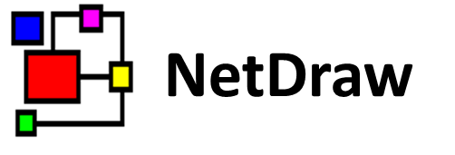




How to visualize ?

Slide 26
Principles of Network Visualization

Slide 27
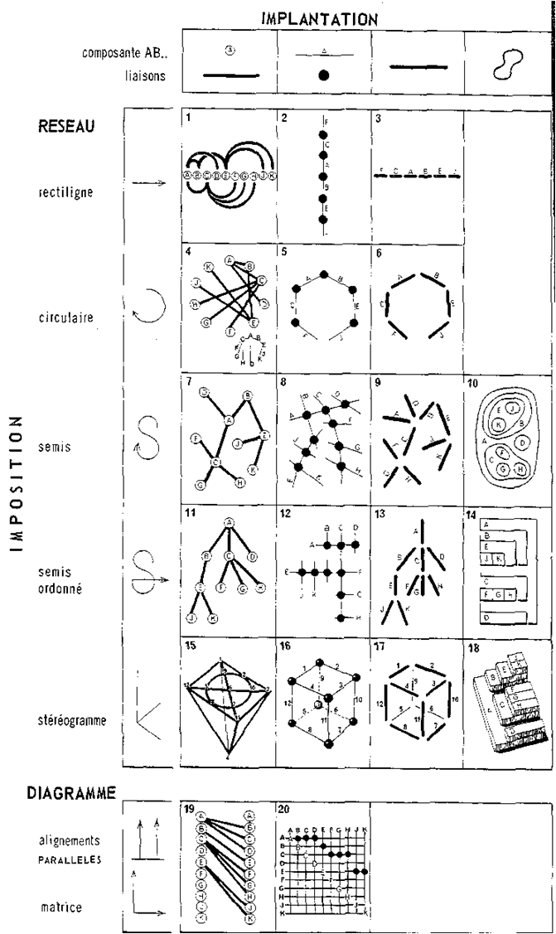
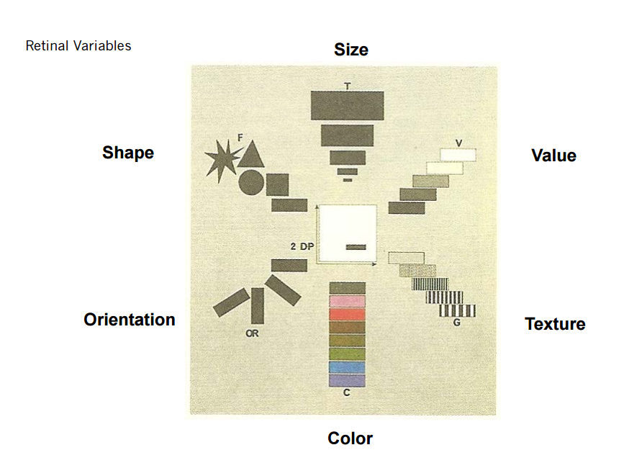
Jacques Bertin 1967
Semiology of Graphics: Diagrams, Networks, Maps

Slide 28
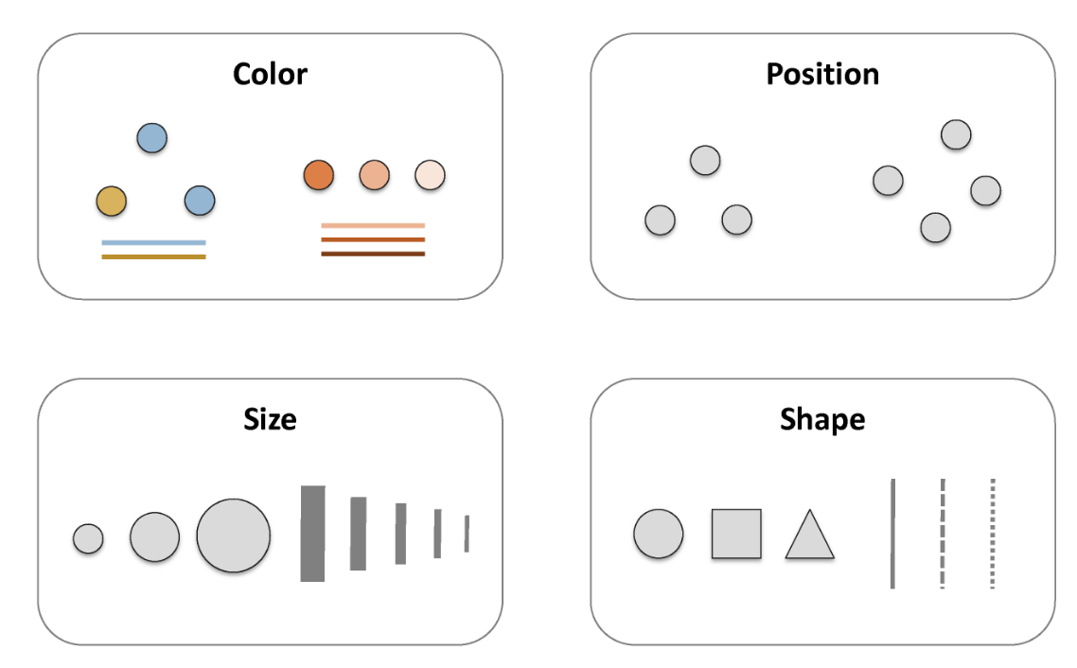
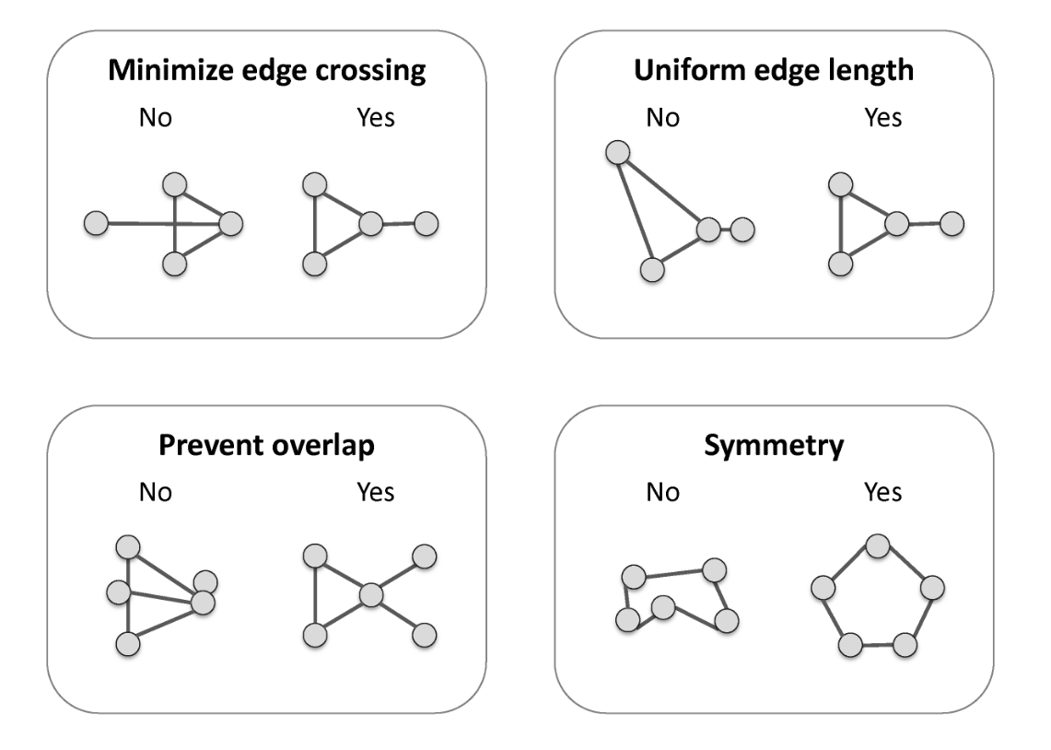
Basic Network Visualization Principles
Katya Ognyanova (Rutgers)

Slide 29
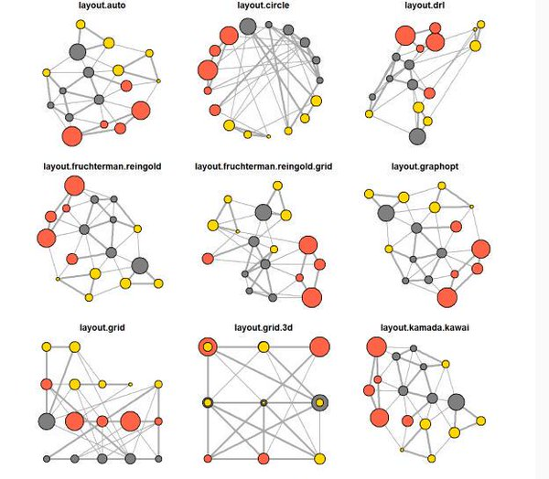
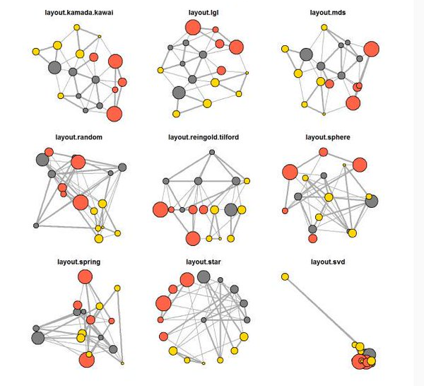
Basic Network Visualization Principles - Layouts
R – igraph package (Gabor Csardi)
Katya Ognyanova (Rutgers)

Slide 30
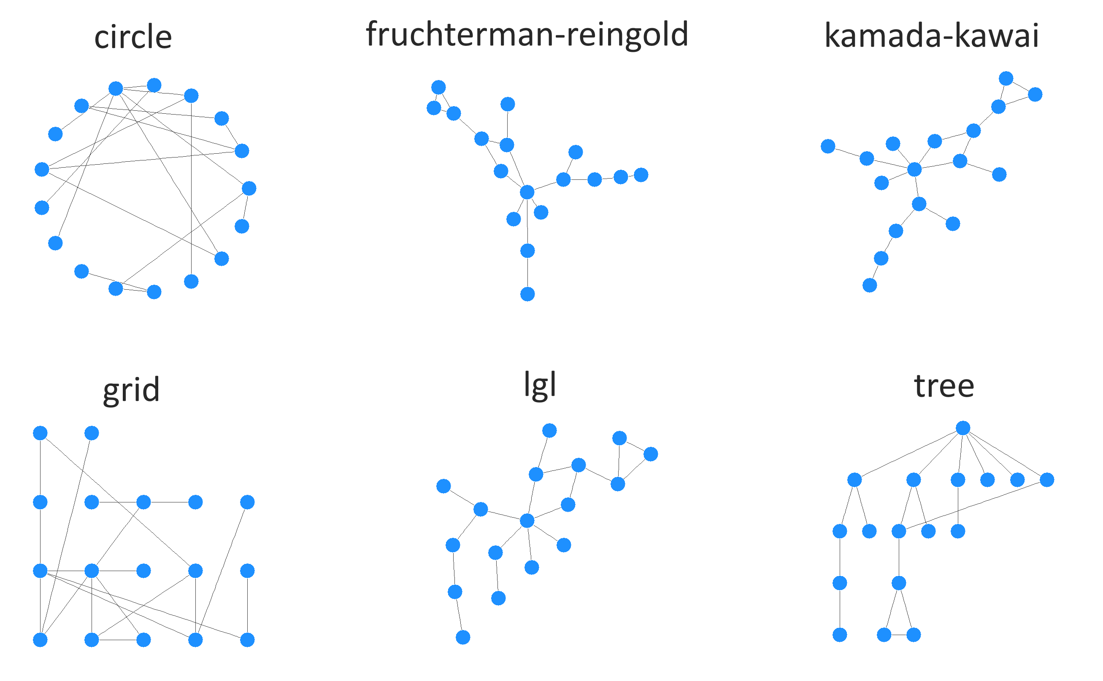

Slide 31
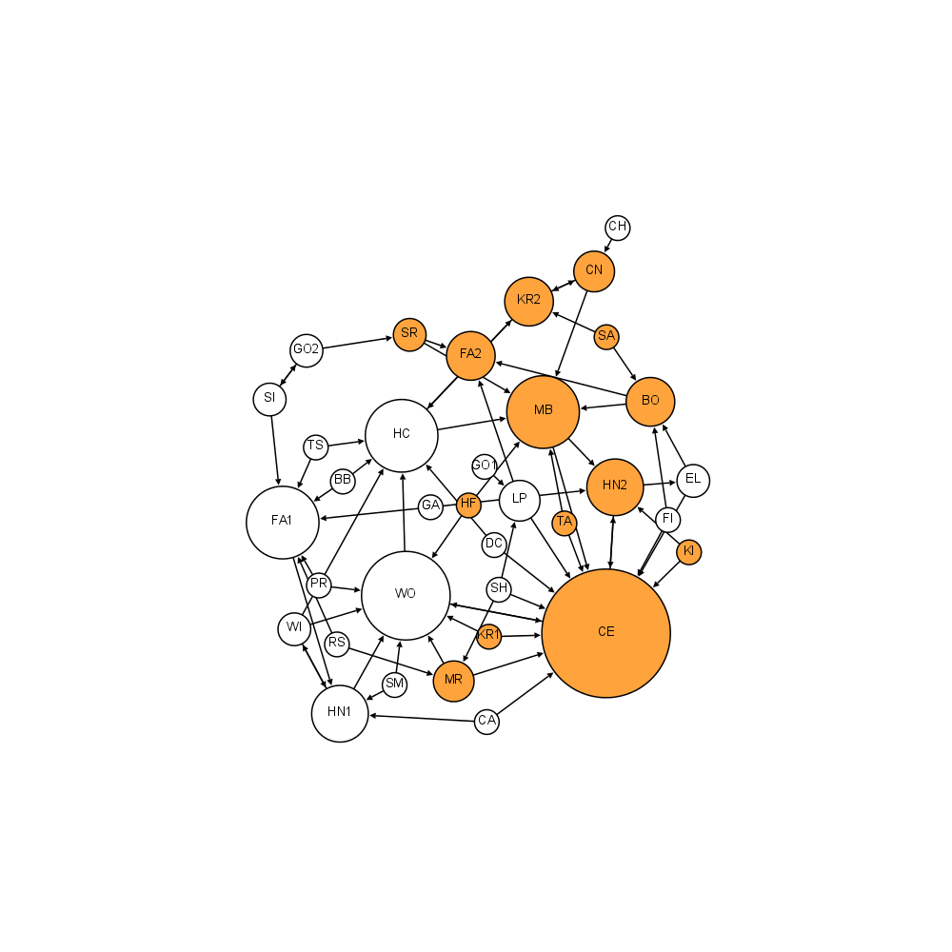
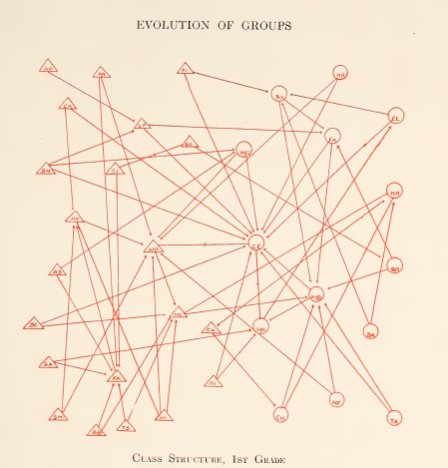
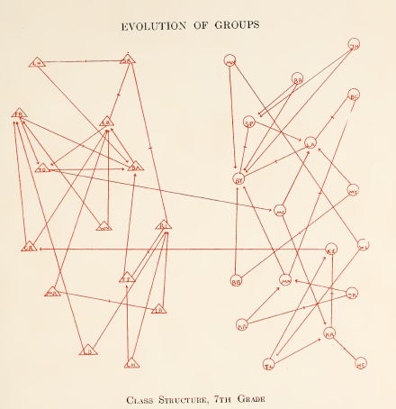
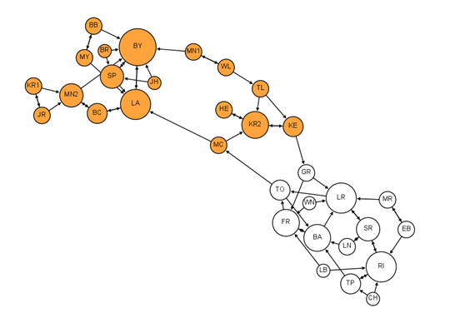
Identifying Network Structures & key nodes
1st Grade
Moreno’s original visualizations remade in Gephi by
Martin Grandjean
G1: 22 boy-girl edges
G7: 2 boy-girl edges
Node size – degree
Node color – gender
orange – girls
white – boys
7th Grade

Slide 32
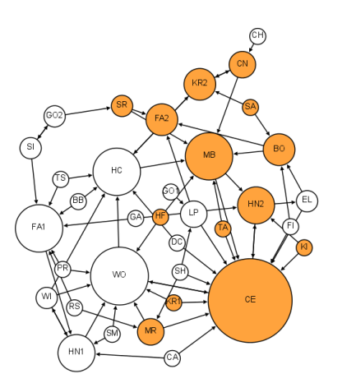
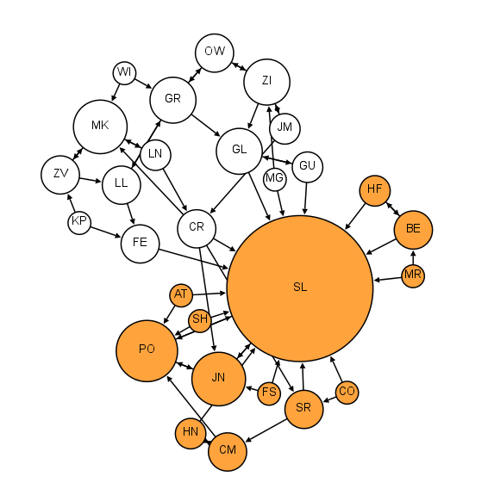
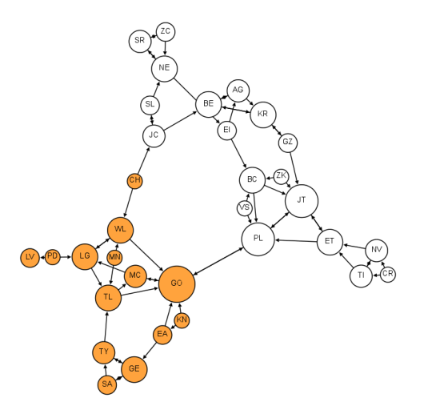
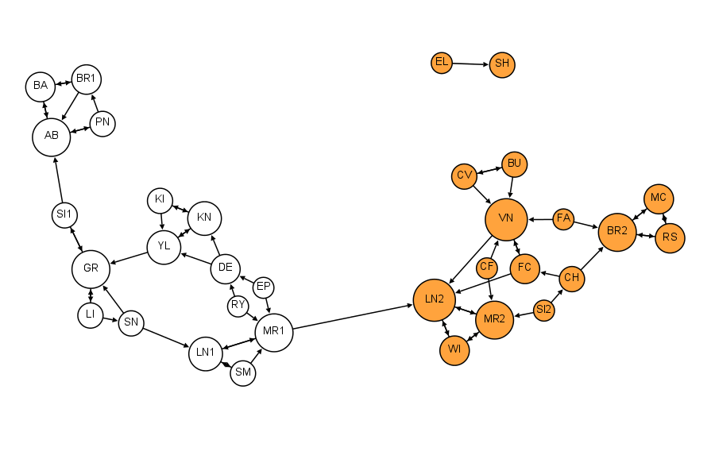
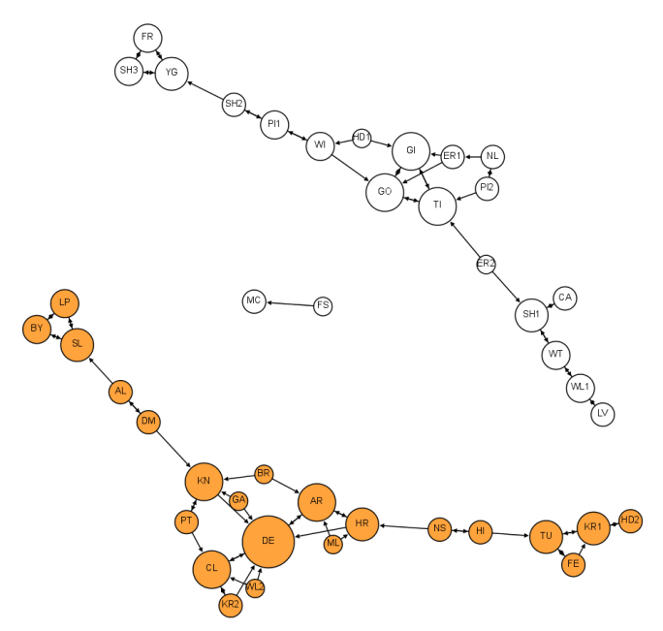
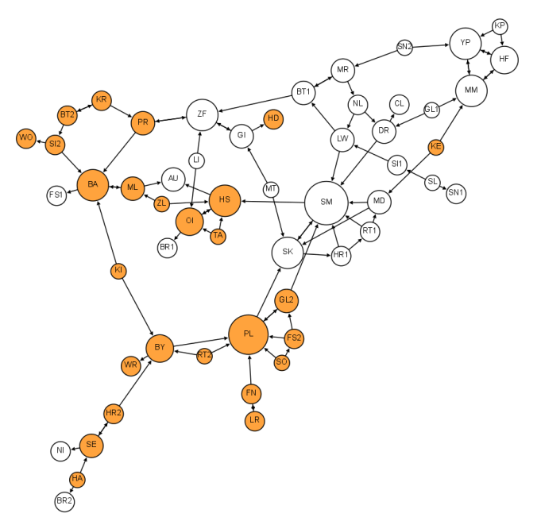
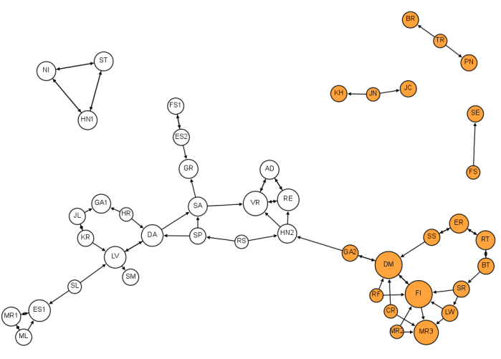
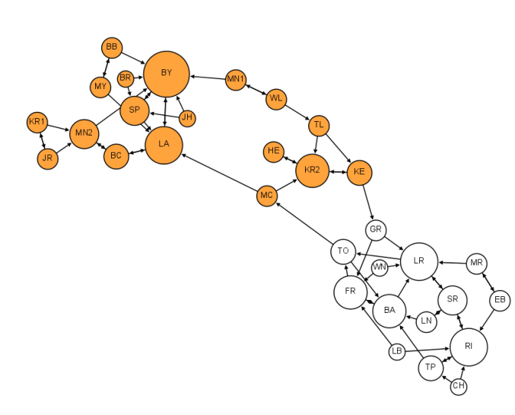
Changes in homophily, reciprocity & community structure across grades
Moreno’s original visualizations remade in Gephi by
Martin Grandjean
G1
G2
G3
G4
G5
G6
G7
G8

Slide 33
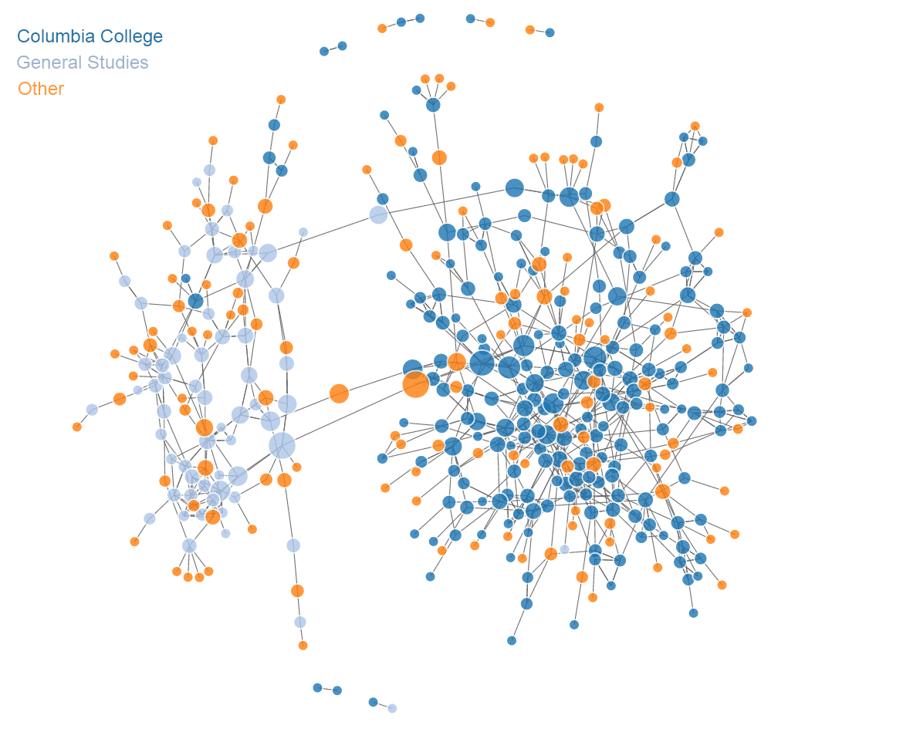
Friendship Network in Columbia Intro Bio Classes
(with Kaytee Turetsky)
Made with D3.js & networkD3 R package

Slide 34
Extensions to Network Visualization
Limits to what can be inferred immediately from a static network visualization
Interactivity – users gain more insight through interactivity & can explore data for themselves
Broswer based :
e.g.
Filtering data
- Mouseover /onClick events
Linked matrices/networks

Slide 35


Filtering Information - less is more
Friendship connections in
German school 1880
e.g. identify neighbors in Gephi
Schmidt has 3 reciprocated friendships, 1 outgoing only & 2 incoming only

Slide 36



Filtering Information - less is more
e.g. identify direct neighbors in D3.js
e.g. identify triads in D3.js
blockbuilder.org/jalapic

Slide 37

Interactivity
e.g. find geodesic distances in D3.js
Who is 1, 2, 3, 4 geodesic distance from Flach ?
blockbuilder.org/jalapic

Slide 38

Interactivity
Friendship connections in
German school 1880
e.g. identify shortest paths
Example – Gephi
Pfeil → Fritzsche → Fährmann → Stolze → Lasch
Pfeil & Lasch have a geodesic distance of 4

Slide 39

Filtering Information - less is more
e.g. Only showing nodes of high betweenness
Made using
rthreejs

Slide 40

3D Network Representations
Community structure
among friends in
Facebook data
(Stanford SNAP repository)
Using rthreejs
Bryan Lewis

Slide 41
Is a network really the right visualization ?

Slide 42


Social Network Analysis of Social Hierarchies
Comparing many networks by
visual inspection may not be
that easy or intuitive
Adjacency Matrix
Network Graph

Slide 43
Mice have unique ranks and show high directional consistency of behavior
R - ggplot2
Williamson et al. Anim Behav 2016.

Slide 44


Small Multiples
Network Formation in African Cichlid Fish
1
7
Every interaction from initial formation through 24 hours
Proportion of time spent in transitive vs. intransitive states
Likelihood of transitioning between transitivity/intransitivity
13
19
25
Intransitive
Transitive
41 unique network types
(Collaboration with Prof Ivan Chase – Stony Brook)
R package - hierformR

Slide 45
Small Multiples
The Rise of Partisanship and Super-Cooperators in the U.S. House of Representatives
Andris et al. PlosOne 2015

Slide 46
Small Multiples
Progression of flu contagion in the friendship network over time.
Edges = friendship nomination
White = uninfected individuals/friends
Red = Infected individuals
Yellow = friends of infected individuals
Node size = proportional to the number of friends infected.
Christakis & Fowler 2010 PlosOne

Slide 47

Animated Networks using R
SEE my ONLINE TUTORIAL …
http://curleylab.psych.columbia.edu/netviz/netviz5.html
SEE recent animations in rthreejs - http://bwlewis.github.io/rthreejs/animation/animation.html

Slide 48

Timelines
(Ivan Chase)

Slide 49

Timelines
Curley 2016 – “musicnotationR” R package

Slide 50

Timelines
Shiny App: https://jalapic.shinyapps.io/music/
Filter all aggressive interactions (incoming & outing) for animal Rank #3 - high directional consistency of behavior
Colors represent unique individuals
Curley 2016 – “musicnotationR” R package

Slide 51

Timelines
Dan Rubenstein- Princeton
PlosOne 2015
Community membership over time in zebras vs onagers

Slide 52
Conclusions
Lots of tools exist to visualize networks
It’s easy to make really attractive network visualizations
It’s also easy to make really bad network visualizations
What question do you want to explore or communicate to an audience?
What’s the most effect way of achieving that?
Learn the programming language / software that will facilitate this !

Slide 53
Links to examples
Katya Ognyanova tutorials - http://kateto.net/
Martin Grandjean work - http://www.martingrandjean.ch/social-network-analysis-visualization-morenos-sociograms-revisited/
My friendship visualization - http://curleylab.psych.columbia.edu/friendship.html
My friendship visualization 2 - http://curleylab.psych.columbia.edu/friends.html
Identifying neighbors in D3js - http://blockbuilder.org/jalapic/0020bebb012760de0d54
Identifying triads in D3js - http://blockbuilder.org/jalapic/aeb4b1085f800d31b4be
Identifying geodesic distance in D3js - http://blockbuilder.org/jalapic/0eba1241acdf67c62f5b87357864d662
rthreejs example by Bryan Lewis - http://jalapic.github.io/facebook
Linked Matrices in D3js - http://curleylab.psych.columbia.edu/socdom1.html
D3js animated network example - http://blockbuilder.org/jalapic/cf1454d62c7efa48d96ee4d803856dfa

Slide 54
A network consists of:
Nodes = individuals, groups, classes of individuals etc.
Node attributes = phenotypic traits of the individual e.g. gender, age, group membership
Edges = relationship between two nodes,
Weighted = frequency of interaction between nodes, or strength of association/relationship
Types of Network
Binary Matrix vs Valued Matrix vs Thresholded
Directed vs Undirected
Static vs Dynamic (Temporal)

Slide 55
Edgelists can be:
- pairwise events
- undirected or directed
- with time of event
- with on/off times
- weighted
Adjacency matrices (sociomatrices) can be:
- frequency of events
- comembership
- association indices
- measure of relatedness
- measure of distance
- nominations (ranks)
- rates of interaction

Slide 56
Both edges and nodes can have attributes:
e.g. EDGES - frequency, weight, type, positive/negative
e.g. NODES – age, sex, group affiliation, personality etc.

Slide 57


Slide 58


Unweighted
Weighted

Slide 59


Slide 60
Measures of Graph Cohesion

Slide 61

Graph Density
Density = the proportion of possible edges in the network. In valued network equates to tie strength

Slide 62


Slide 63

Components
Giant component – component with largest number of nodes (typically used when component is large fraction of graph)
Isolates can be components of size 1
Component Ratio = CR = c - 1 / n -1 (c is number of components, n is number of nodes in the graph)
Maximum is 1 when every node is an isolate. Minimum of 0 when whole network is one component. An inverse measure of cohesion.
CR = 0.33

Slide 64

Components
Strong component - in directed graphs, all nodes can reach each other via directed paths
Weak component – in directed graphs, all nodes cannot reach each other via directed paths
weak
strong

Slide 65

Geodesic Distance
Distance from each node to each other

Slide 66

Paths
A path is a walk in which each other actor and each other relation in the graph may be used at most one time
A trail between two actors is any walk that includes a given relation no more than once (the same other actors, however, can be part of a trail multiple times.
Undirected network - either direction
Directed network - can only go via direction of edge
Shortest path – the shortest number of steps between any pair of node
Diameter – the longest shortest path in the graph
Average path length – the average shortest path between all pairs of nodes
Diameter = 4
Average path length = 2.47

Slide 67


Slide 68


Directed Connectedness
What proportion of pairs of nodes can reach each other?:
Can row node reach column node ?
Directed Connectedness = 0.41

Slide 69

Directed Connectedness
Geodesic distance matrix
Directed Connectedness = 0.41

Slide 70

Neighbors
Co-citation is a method for identifying how many neighbors in common nodes have and is a measure of neighborhoods
D and F have 2 neighbors in common
Neighbors are nodes that are connected

Slide 71

Reciprocity
What proportion of dyads have mutual/ bidirectional/ symmetrical/ reciprocated edges?

Slide 72

Transitivity
Triad census

Slide 73


Slide 74
Clustering Coefficient
Transitivity relates to Watts & Strogatz clustering coefficient for undirected networks
Get the individual clustering of each node (density of ties in each ego network). Then the clustering coefficient is a weighted average of individual clustering coefficients across all nodes.
High clustering may occur in networks that aren't globally cohesive (local vs global cohesion)
(Watts&Strogatz 1998)
3 x number of triangles in the graph
C =
number of connected triples

Slide 75
Local Clustering Coefficient
For each node, calculate the number of its neighbors who share a connection. This can be used to calculate the local clustering coefficient (local transitivity) for each node.
No. directed connections between i’s neighbors
C.directed =
n_{i} * (n_{i} -1)
No. undirected connections between i’s neighbors
C.undirected =
n_{i} * (n_{i} -1)/2
(Watts&Strogatz 1998)
n_{i} = number of neighbors of i

Slide 76
Comparing networks with correspondence analysis
e.g. comparison of triads between networks (K. Faust - https://www.stat-d.si/mz/mz3.1/faust.pdf)

Slide 77



Slide 78



Slide 79



Slide 80



Slide 81
Node Metrics

Slide 82
Degree Centrality
A B C E D F H J K M L I G
6 2 2 3 4 4 3 1 1 1 1 1 1

Slide 83

Degree Centrality

Slide 84
Betweenness Centrality
How many shortest paths each node lies on when examining all pairs of nodes. If multiple shortest paths between two nodes – shared credit for each node. Individuals who have high betweenness are bridges connecting nodes from different parts of the network.
Norm Total
A 0.70 46
B 0.17 11
C 0.17 11
E 0.17 11
D 0.32 21
F 0.18 12
H 0.05 3
J 0.00 0
K 0.00 0
M 0.00 0
L 0.00 0
I 0.00 0
G 0.00 0
Freeman 1979

Slide 85
Eigenvector Centrality
Higher in individuals who are well-connected and connected to others who are also well-connected. Related to sum of centralitites of neighbors
A 1.00
B 0.33
C 0.33
E 0.58
D 0.63
F 0.76
H 0.71
J 0.10
K 0.10
M 0.19
L 0.19
I 0.17
G 0.23
Bonacich 1972

Slide 86
Closeness Centrality
Related to the sum of geodesic distances from a node to all others. Essentially the inverse of a node's average geodesic distance to others in the network.
A 0.67
B 0.44
C 0.44
E 0.48
D 0.50
F 0.50
H 0.50
J 0.32
K 0.32
M 0.34
L 0.34
I 0.33
G 0.34
Closeness centrality is problematic in disconnected networks as no path exists between pairs of nodes. Also not particularly useful for directed networks due to fragmentation
Freeman 1979

Slide 87
K-reach Centrality
What proportion of nodes can be reached in K steps from each node ?
K=2 K=3
A 1.00 1.00
B 0.62 1.00
C 0.62 1.00
E 0.69 1.00
D 0.69 1.00
F 0.69 1.00
H 0.77 1.00
J 0.23 0.62
K 0.23 0.62
M 0.38 0.69
L 0.38 0.69
I 0.31 0.69
G 0.38 0.69
Borgatti 2006

Slide 88
Hub Score
Hubs provide many links to other vertices (many outgoing ties) and are key drivers of flow
raw norm
A 0.19 0.26
E 0.00 0.00
F 0.72 1.00
H 0.00 0.00
B 0.39 0.54
C 0.39 0.54
D 0.39 0.54
L 0.00 0.00
J 0.00 0.00
K 0.00 0.00
G 0.00 0.00
I 0.00 0.00
Kleinberg

Slide 89
Authority Score
Authorities receive many incoming links particularly from hubs
raw norm
A 0.85 1.00
E 0.41 0.48
F 0.00 0.00
H 0.00 0.00
B 0.00 0.00
C 0.00 0.00
D 0.00 0.00
L 0.00 0.00
J 0.00 0.00
K 0.00 0.00
G 0.33 0.38
I 0.00 0.00
Kleinberg

Slide 90
Page Rank
A 0.16
E 0.21
F 0.20
H 0.19
B 0.02
C 0.03
D 0.05
L 0.02
J 0.02
K 0.02
G 0.07
I 0.02
Brin & Page 1998

